Slide 1
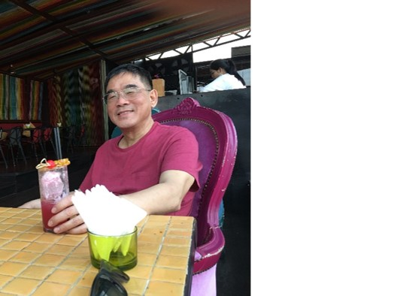
Database Lab 7b
Correction to
Database Modification
Addendum
Dr. Jefferson Fong

Slide 2
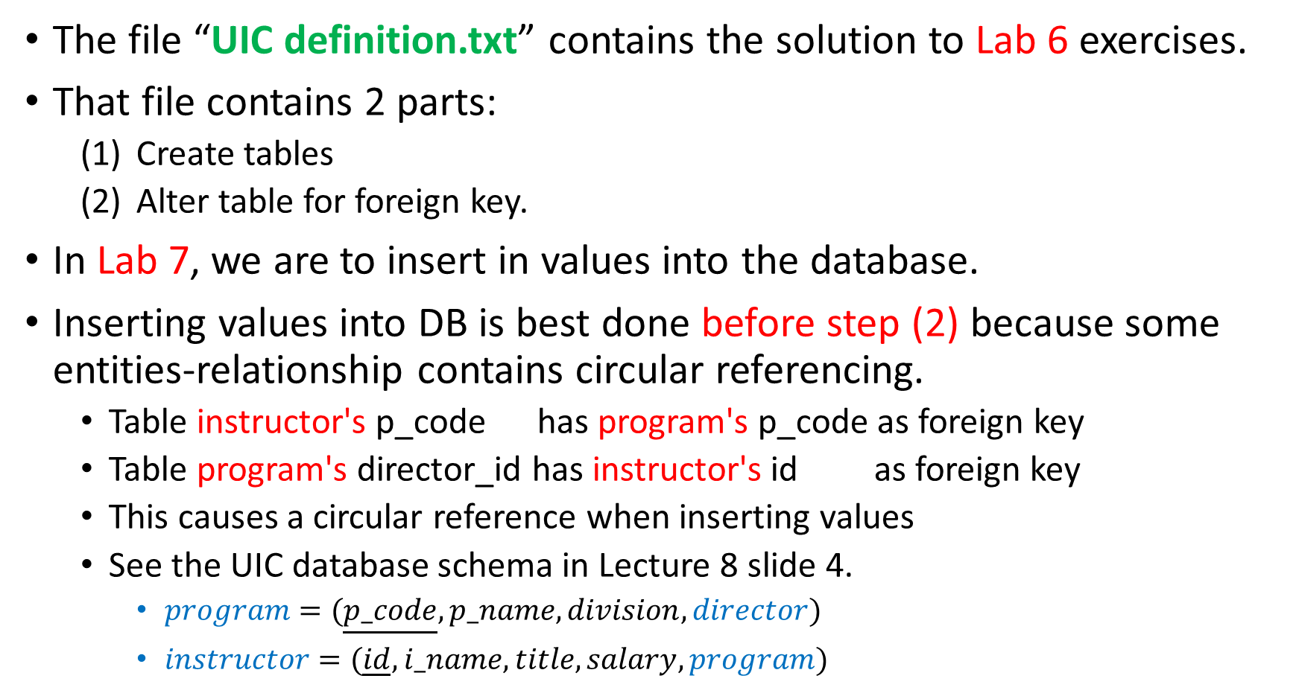
The file “UIC definition.txt” contains the solution to Lab 6 exercises.
That file contains 2 parts:
  Create tables
  Alter table for foreign key.
In Lab 7, we are to insert in values into the database.
Inserting values into DB is best done before step (2) because some entities-relationship contains circular referencing.
  Table instructor's p_code has program's p_code as foreign key
  Table program's director_id has instructor's id as foreign key
  This causes a circular reference when inserting values
  See the UIC database schema in Lecture 8 slide 4.
    $program=(\underline{p_code},p_name,division,director)$
    $instructor=(\underline{id},i_name,title,salary,program)$

Slide 3
For Lab 7, it’s best to follow these steps
  Create all the tables
    CREATE TABLE `instructor` (
    `id` int(11) NOT NULL,
    `i_name` varchar(20) NOT NULL,
    `title` varchar(20) NOT NULL,
    `salary` int(11) NOT NULL,
    `p_code` int(11) NOT NULL)
  (1a) Insert the values into all the tables
    INSERT INTO `instructor` (`id`, `i_name`, `title`, `salary`, `p_code`) VALUES
    (20002, 'S.H. Zee', 'Professor’, 100000, 1002),
    (20003, 'Eva', 'Professor', 80000, 1003),
    (20004, 'Howard', 'Lecturer', 20000, 1003),
    (20005, 'Stephen', 'Associate Professor', 60000, 1001),
    (20006, 'Paul', 'Lecturer', 10000, 1004),
    (20007, 'Kevin', 'Professor', 80000, 1004);

Slide 4
  (2a) Specify the primary keys in all the tables.
    ALTER TABLE `instructor` ADD PRIMARY KEY (`id`), ADD KEY `p_code` (`p_code`);
  (2b) Specify the foreign keys in all the tables.
    ALTER TABLE `instructor` ADD CONSTRAINT `instructor_ibfk_1` FOREIGN KEY (`p_code`) REFERENCES `program` (`p_code`);
The foreign keys should be specified in the last step to avoid circular referencing problem.
  In tables instructor and program, if you have put in the foreign keys before inserting the values, you might have to remove the foreign keys before inserting the values.
  See the document Lab7 Notes.docx on how to do that.

